Slide 1
Hyperplane based Classifiers (3): SVM – Some Extensions
CS771: Introduction to Machine Learning
Piyush Rai

Slide 2
Plan
A co-ordinate ascent based optimization algo for SVM
Some extensions of binary SVM
Multi-class classification using SVM
One-class classification (a.k.a. novelty/outlier detection)SVM

Slide 3
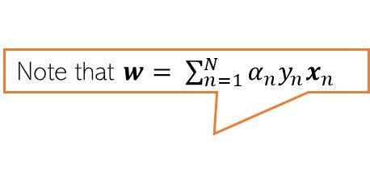
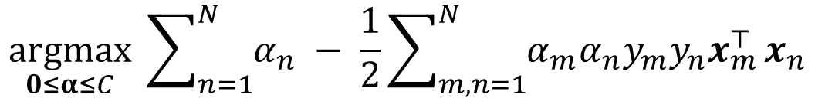
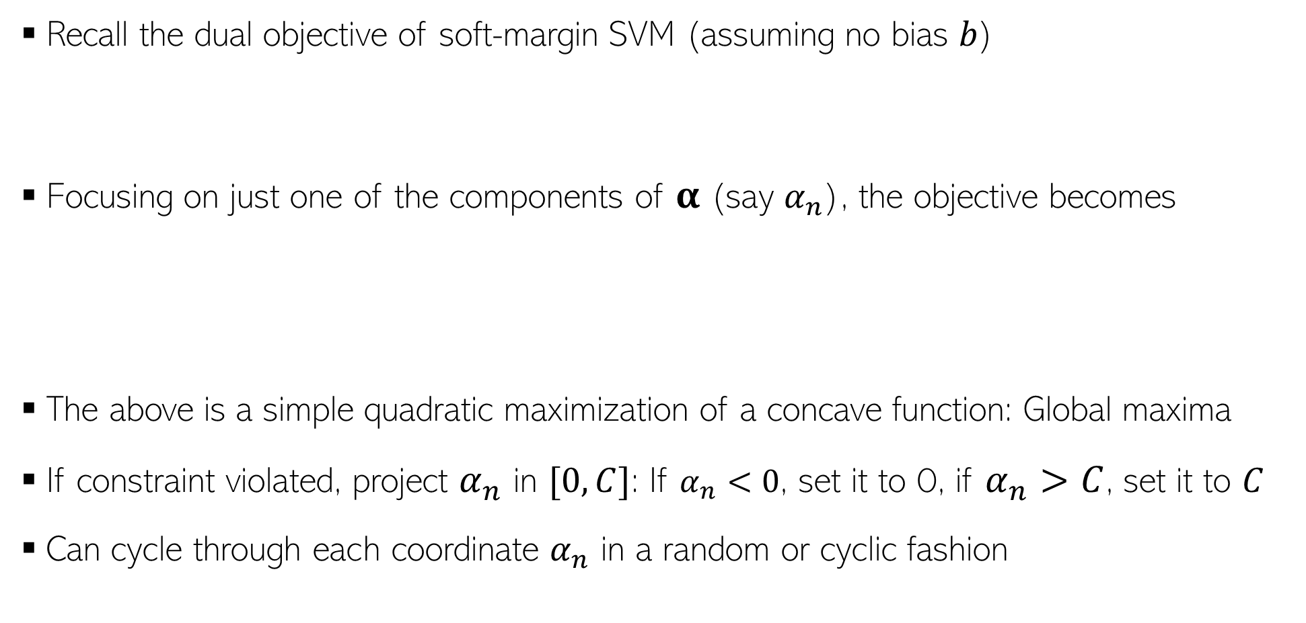
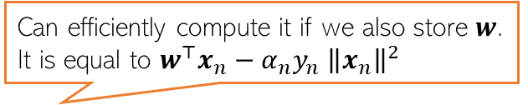
A Co-ordinate Ascent Algorithm for SVM
Recall the dual objective of soft-margin SVM (assuming no bias $b$)
Focusing on just one of the components of $α$ (say $α_{n}$), the objective becomes
The above is a simple quadratic maximization of a concave function: Global maxima
If constraint violated, project $α_{n}$ in $[0,C]$: If $α_{n}<0$, set it to 0, if $α_{n}>C$, set it to $C$
Can cycle through each coordinate $α_{n}$ in a random or cyclic fashion
$$\underset{0≤α≤C}{argmax} \sum_{n=1}^{N}{α_{n}} − \frac{1}{2}\sum_{m,n=1}^{N}{α_{m}α_{n}y_{m}y_{n}x_{m}^{⊤}}x_{n}$$
Note that $w= \sum_{n=1}^{N}{α_{n}y_{n}x_{n}}$
Can efficiently compute it if we also store $w$. It is equal to $w^{⊤}x_{n}−α_{n}y_{n}$ ${\left\|x_{n}\right\|}^{2}$
Can compute these in the beginning itself
$\underset{0≤α_{n}≤C}{argmax} α_{n}−\frac{1}{2}α_{n}^{2 }{\left\|x_{n}\right\|}^{2} −\frac{1}{2}α_{n}y_{n}\sum_{m≠n}{α_{m}y_{m}x_{m}^{⊤}}$ $x_{n}$

Slide 4
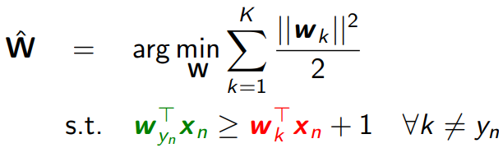
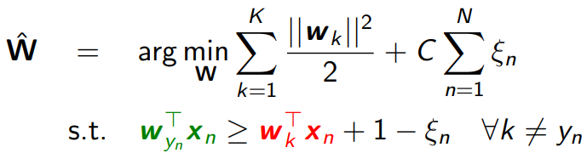



Multi-class SVM
Multiclass SVMs (assuming $K > 2$classes) use $K$ wt vectors $W = [w_{1},w_{2},…,w_{K}]$
Like binary SVM, can formulate a maximum-margin problem (without or with slacks)
The version with slack corresponds to minimizing a multi-class hinge loss
Prediction at test time:
$\hat{y_{∗}}={argmax}_{k∈\{1,2,…,K\}} w_{k}^{⊤}x_{∗}$
Score on correct class
Score on an incorrect class $k≠y_{n}$
Crammer-Singer
Multi-class SVM
$$ℒ\left(W\right)= \sum_{n=1}^{N}{max\left\{0, 1+\max_{k≠y_{n}}{ w}_{k}^{⊤}x_{n} −w_{y_{n}}^{⊤}x_{n}\right\}+ }\frac{λ}{2}\sum_{k=1}^{K}{{\left\|w_{k}\right\|}^{2}}$$
Loss=0 if score on correct class is at least 1 more than score on next best scoring class

Slide 5
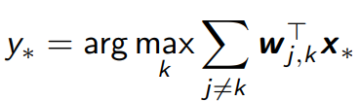
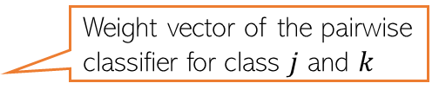
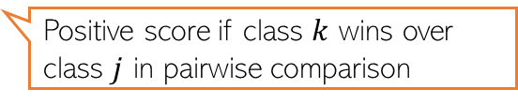

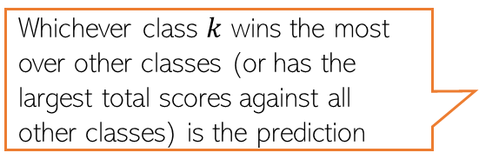
Multi-class SVM using Binary SVM
Can use binary classifiers to solve multiclass problems
One-vs-All (also called One-vs-Rest): Construct $K$ binary classification problems
All-Pairs: Learn $K$-choose-2 binary classifiers, one for each pair of classes $(j, k)$
Solid lines: one-vs-all boundaries
Dotted lines: Effective multi-class boundaries
Weight vector of the pairwise classifier for class $j$ and $k$
Whichever class $k$ wins the most over other classes (or has the largest total scores against all other classes) is the prediction
Positive score if class $k$ wins over class $j$ in pairwise comparison

Slide 6
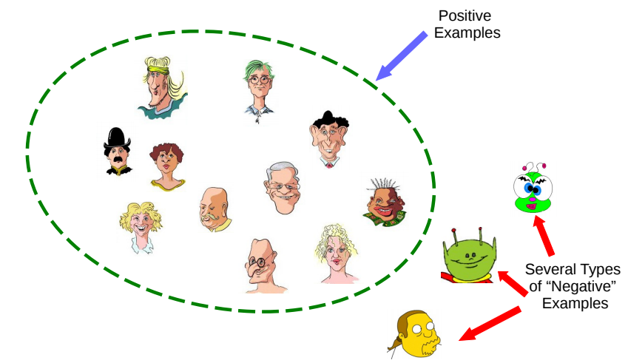

One-class Classification
Can we learn from examples of just one class, say positive examples?
May be desirable if there are many types of negative examples
One-class classification is an approach to learn using only one class of examples
“Outlier/Novelty Detection” problems can also be formulated like this
Pic credit: Refael Chickvashvili

Slide 7
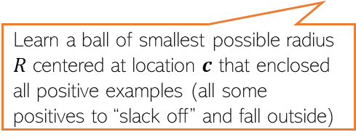
One-class Classification via SVM-type Methods
There are two popular SVM-type approaches to solve one-class problems
“One-Class SVM” (OC-SVM)
[Schölkopf et al., 2001]
“Support Vector Data Description” (SVDD)
[Tax and Duin, 2004]
Allow some slack for the positive examples
Learn a ball of smallest possible radius $R$ centered at location $c$ that enclosed all positive examples (all some positives to “slack off” and fall outside)
Pretend that origin represents all the negative examples (note: we aren’t given any of those)
Supporting hyperplane (as in binary SVM)
Origin
Decision boundary

Slide 8
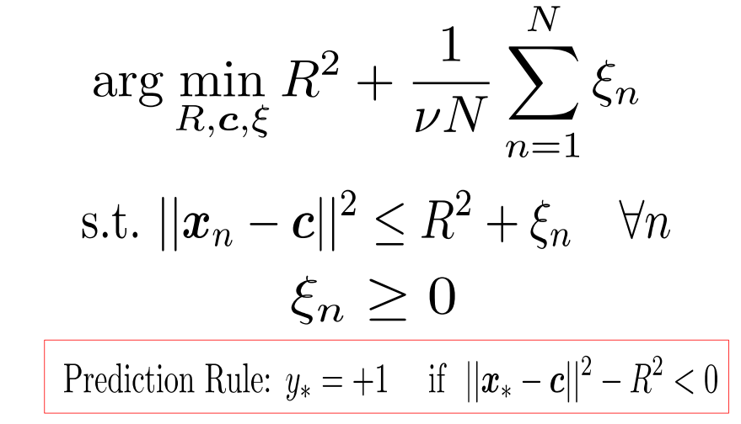

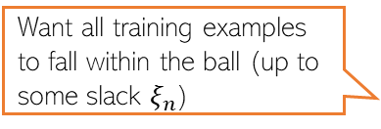
One-class Classification via SVM-type Methods
Hyperparameter $ν$ to trade-off b/w the two terms
Want to keep training error (sum of slacks) to be small
“Support Vector Data Description” (SVDD)
[Tax and Duin, 2004]
Want to keep the ball’s radius as small as possible
Want all training examples to fall within the ball (up to some slack $ξ_{n}$)

Slide 9
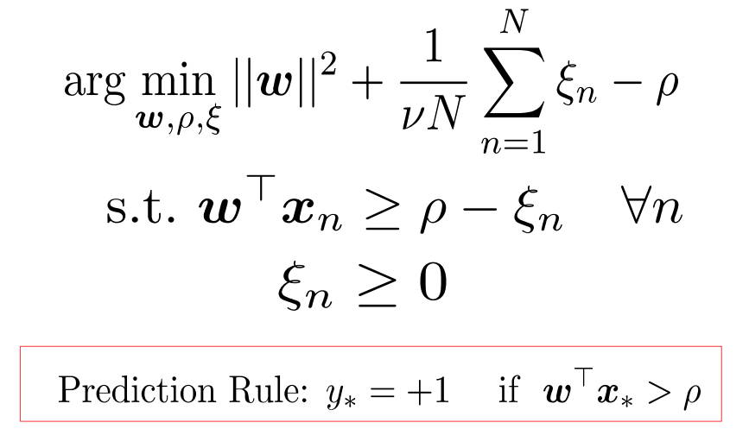
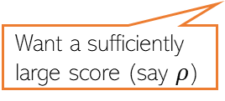
One-class Classification via SVM-type Methods
“One-Class SVM” (OC-SVM)
[Schölkopf et al., 2001]
Want to keep training error (sum of slacks) to be small
Maximize the margin (similar to binary SVM)
An offset term (want it large)
Want a sufficiently large score (say $ρ$)
Origin

Slide 10
Coming up next
Kernel methods and nonlinear SVM via kernels

